Slide 1
PRACTICAL EXAM PRESENTATION
Product Sales

Slide 2
Business Goals
. Launching a new product line is expensive. What is most effective strategy in launching new product line.
What are the differences between each of the various sales method used (Email, Call, Email and Call).

Slide 3
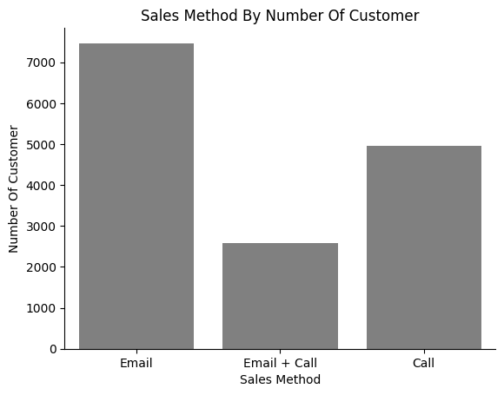
Outcomes
The amount of customers from each sales method used
Over the last six weeks, EMAIL was the preferred method for buying stationaries from us. According to the plot, the Email method attracted over 2000 extra customers (over 7000 in total) compared to the second best method, which was Call with nearly 5000 customers. Email + Call had the fewest customers(above 2000).

Slide 4
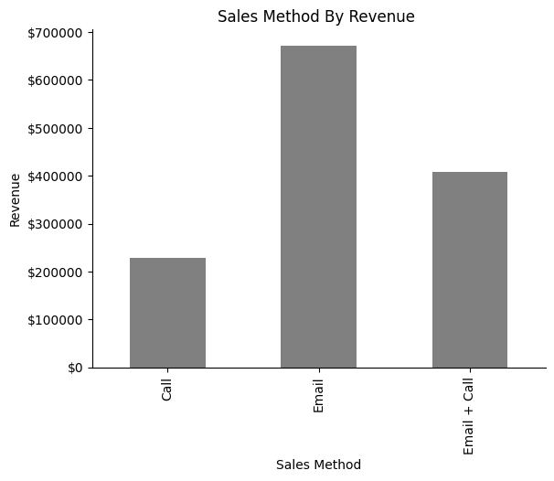
Total revenue generated for each sales method
In terms of revenue generated in the same period (last 6 weeks), Email also performed better than the other sales methods used, generating over 650,000 in total. The second sales method in terms of total revenue was Email + Call, which generated approximately 400,000, considering it had the lowest number of customers. The least in terms of revenue was Call, sitting slightly above 200,000.
Note: the total revenue generated was $1,308,138.01.

Slide 5
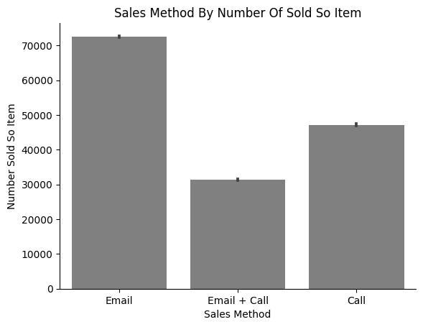
Total amount of product sold for each category
For the the amount of products sold, Email had the highest which is no surprise because they had the highest amount of customers and generated more revenue.

Slide 6
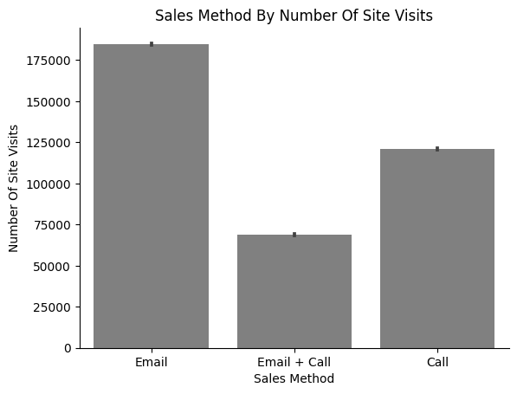
Number of times customers visited our website for each sales method
When we take a look at the plot below ,the customers in the Email category visited the site the most in the last 6 months in total above 175000 times, followed by Call (less than 125,000) and the least in terms of visit is Email + Call below 75,0000

Slide 7
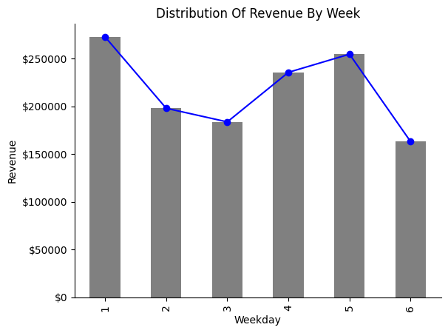
Distribution of total revenue generated over 6 weeks
From the plot below showing the distribution of revenue across 6 weeks since product launch, the first week generated over 250,000, which dropped below $200,000 in the third week and rose back up to approximately 250,000. It then dropped again, getting closer to 150,000.

Slide 8
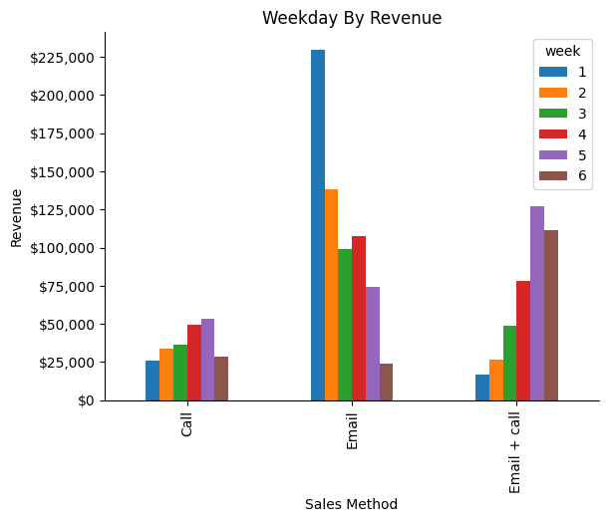
Distribution of total revenue generated over 6 weeks- for each sales category
Email (sales method) in the middle of the plot, it began strongly with around 225,000 in revenue generated during its first week but dropped to less than 25,000 by its 6th week. The right side of this plot is Email + Calls, which started with low revenue (less than 25,000) but steadily grew over time and ended up generating over 100,000 by its 6th week.

Slide 9
RECOMMENDATION
Based on the past week's data, the Email sales method outperformed others. However, the Email + Call method, while having fewer customers, ranked second in generating revenues and showcased promising potential. The top 50 revenue-generating customers and those who visited the site most frequently were primarily from the Email + Call group. Therefore, i recommend adopting the Email + Call approach as our primary sales method, pending further data analysis.

Slide 10
Additional Recommendation
Continual Monitoring: Maintain a vigilant approach to monitor the performance of each sales method, allowing for adjustments as needed to optimize results.
Data Collection: Gather more comprehensive customer data within each group to gain deeper insights into why the Email + Call method was more successful. This could include demographics, interests, and purchase behavior etc.
Diversify Sales Methods: Explore the possibility of experimenting with alternative sales methods, such as social media marketing or in-person events, to diversify our approach and potentially tap into untapped customer segments.
Incorporating these recommendations will help us leverage the Email + Call method's success and ensure a well-rounded sales strategy for continued growth.

